Slide 1
CS422 Database systems
Introduction
Data-Intensive Applications and Systems (DIAS) Laboratory École Polytechnique Fédérale de Lausanne
“The world is one big data problem” – Andrew McAfee
Some slides adapted from:
Andy Pavlo
CS-322
Notes:
Welcoming and introduction
I am sorry, the professor is on a very important trip and she will be teaching next weeks course.

Slide 2
Course Overview
Data management systems:
Design
Implementation
Principles

Slide 3
Prerequisites
Required courses
CS-105: Introduction to object-oriented programming
CS-150: Discrete structures
CS-322: Introduction to database systems
Recommended courses
CS-323: Operating systems
Refresh your database knowledge

Slide 4
Course Outline
Relational Databases
Storage
Execution
Optimization
Data Warehouses
Distributed Computing
Stream Processing
Transaction Processing

Slide 5

Textbook & more
Database Management Systems
3rd Edition
Ramakrishnan & Gehrke
Surveys on state-of-art
Seminal Papers & Articles

Slide 6
Grading Scheme
Projects (30%)
Midterm Exam (30%)
Final Exam (40%)

Slide 7
Projects
Project I: Build your own database engine
Express database operators using Java
10% of overall grade
Individual
Announced: 6/03
Deadline: 24/03
Project II: Develop distributed computing apps
Batch, in-memory, and real-time analytics over Spark
Spark (Java or Scala) API
20% of the overall grade
2 person groups
Announced: 10/04
Deadline: 19/05

Slide 8
Exams
Mid-term Exam (April 4th)
!!Midterm will take place during exercise session!!
Final Exam (May 29th)
Closed book.

Slide 9


Lecturers
Anastasia Ailamaki
Angelos Anadiotis

Slide 10




TAs
Wednesdays, 13:15, @ SG0213 (only when announced)
Thursday, 10:15, @BC01 (always)
Matt Olma
Stella Giannakopoulou
Periklis Chrysogelos
Panos Sioulas
Exercise sessions
Further discussion
Answering questions

Slide 11
DATABASE
An organized collection of inter-related data that models some aspect of the real world.
Databases are the core component of most computer applications.

Slide 12
DATABASE EXAMPLE
Create a database that models a digital music store
Things to store:
Information about Artists
What Albums those Artists released
The Tracks on those Albums

Slide 13
Entity-relationship diagram
name
country
Artists have
name
country of origin
Albums have
name
release year
Tracks have
name
number
Artist
has
name
Album
year
has
Track
name
number
Describe data via objects and their relationships

Slide 14
Storage Option : Flat CSV (Excel) files
Artist(name, country)
“Mogwai”, “Scotland” “Justin Bieber”,“Canada”
“Eluveitie”, “Switzerland”
File per entity
Application has to parse data for every record read/update
Album(name, artist, year)
“Mr.Beast”,“Mogwai”,2006 “Atomic”,“Mogwai”,2015
“Helvetios”,Eluveitie”,2012

Slide 15
Storage Option : Flat CSV (Excel) files
Album(name, artist, year)
File per entity
Application has to parse data for every record read/update
Example:
Get albums published in 2012
“Mr.Beast”,“Mogwai”,2006 “Atomic”,“Mogwai”,2015
“Helvetios”,Eluveitie”,2012
for line in file: record = parse(line)
if 2012 == int(record[2])
print record[0]

Slide 16
Flat files: Data Integrity
How do we ensure that the artist is the same for each album entry?
What if somebody overwrites the album year with an invalid string?
How do we store that there are multiple artists on an album?

Slide 17
Flat files: Implementation
How do you find a particular record?
What if we now want to create a new application that uses the same database?
What if two threads try to write to the same file at the same time?

Slide 18
Flat files: Durability
What if the machine crashes while we’re updating a record?
What if we want to replicate the database on multiple machines for high availability?

Slide 19
Database Management System
A DBMS is software that allows applications to store and analyze information in a database.
A general-purpose DBMS is designed to allow the definition, creation, querying, update, and administration of databases.
DBMSs are used in (almost) every application, web site, software system you can think of.

Slide 20
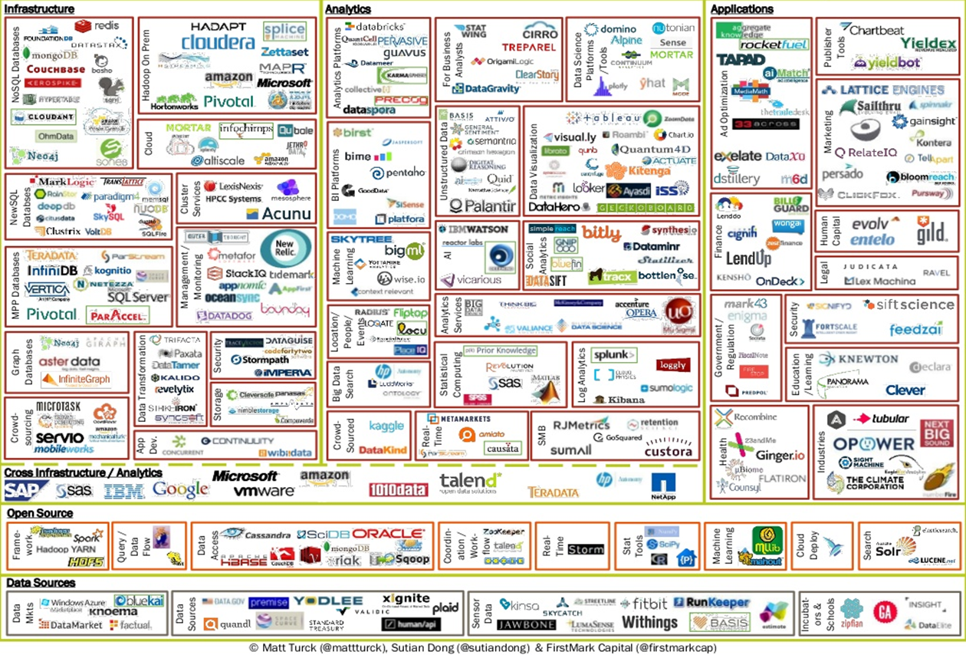

Slide 21
Modern applications are backed by (way too) many DBMSs
1000s of buzzwords / systems
This course: The common principles behind them all

Slide 22


Why data management principles matter
Notes:
Ok, so there is a lot of data, we have established this.
But why does this have to be correlated with you taking the database systems course?
Question: How many people know the person on the left?
He is Jonathan Abrams. He made Friendster, the pre-facebook social network.
Similar to facebook but never reached the popularity of Facebook because of data management issues – it was lagging and crashing as more users were connecting.
The person on the right is bit more famous nowadays, and a lot richer. Why? Because he realized that he needed data management people for his social network website to not crash horribly.
The amounts of data being generated call for sophisticated data management techniques

Slide 23
Course Orientation
A broad perspective of database management systems
Database internals: storage, execution, optimization, transa column stores, optimizations, transaction & analytical processing
Distributed computing: Big Data, data analytics, distributed databases
Programming paradigms: MapReduce, stream processing
Notes:
Some more motivation.
SQL, the “relational database language”, is among the most popular programming languages out there.
Recently, the “data analyst” trend also popped up. Any type of practitioner, from statistician to marine biologist, is expected to have “Data crunching” skills, and be able to deal with data management.

Slide 24
Database Management System
A DBMS is software that allows applications to store and analyze information in a database.
A general-purpose DBMS is designed to allow the definition, creation, querying, update, and administration of databases.

Slide 25









DBMS Types: Target Workloads
On-line Transaction Processing
Fast operations that only read/update a small amount of data each time.
On-line Analytical Processing
Complex queries that read a lot of data to compute aggregates.
Hybrids do exist!

Slide 26
DBMS Types: Data Model
Relational
Key/Value
Graph
Document
Column-family
Array / Matrix
Hierarchical
Network
Most DBMSs
NoSQL
Machine Learning
Rare

Slide 27
Relational Model
A relation is an unordered set that contain the relationship of attributes that represent entities.
A tuple is a sequence of attribute values in the relation
Artist(name, country)
name | country
Mogwai | Scotland
Justin Bieber | Canada
Eluveitie | Switzerland

Slide 28
Relational Model: Primary Keys
A relation’s primary key uniquely identifies a single tuple.
Some DBMSs support auto-generation of unique integer primary keys.
SEQUENCE (SQL:2003)
AUTO_INCREMENT (MySQL)
Artist(id, name, country)
id | name | country
123 | Mogwai | Scotland
456 | Justin Bieber | Canada
789 | Eluveitie | Switzerland

Slide 29
Relational Model: Foreign Keys
A foreign key specifies that an attribute from one relation has to map to a tuple in another relation.
Album(id, name, artist, year)
id | name | artist | year
11 | Mr. Beast | Mogwai | 2006
22 | Atomic | Mogwai | 2015
Artist(id, name, country)
id | name | country
123 | Mogwai | Scotland
456 | Justin Bieber | Canada
789 | Eluveitie | Switzerland
Album(id, name, artist_id, year)
id | name | artist_id | year
11 | Mr. Beast | 123 | 2006
22 | Atomic | 123 | 2015

Slide 30
Relational Model: Queries
The relational model is independent of any query language implementation.
SQL is the de facto standard.
for line in file: record = parse(line)
if 2012 == int(record[2])
print record[0]
SELECT name FROM album WHERE year = 2012

Slide 31
Data Manipulation Languages (DML)
How to store and retrieve information from a db.
(Procedural) Relational Algebra: Query specifiers high-level strategy the DBMS should use to find the desired result
(Non-procedural) Relational Calculus: The query specifies only what data is wanted and not how to find it

Slide 32
Data Manipulation Languages (DML)
How to store and retrieve information from a db.
(Non-procedural) Relational Calculus: The query specifies only what data is wanted and not how to find it
(Procedural) Relational Algebra: Query specifiers high-level strategy the DBMS should use to find the desired result

Slide 33
Relational Calculus
Tuple Relational Calculus:
Uses variables whose permitted values are tuples
Domain Relational Calculus:
Uses variables to select attributes (instead of tuples).
Both are equivalent to relational algebra!
$$\{t|t∈R∧t.a_{id}=′a2^{′}∧t.b_id>102\}$$
$$\{<a_{id},b_id>|<a_{id},b_{id}>∈R∧a_{id}=′a2^{′}∧b_id>102\}$$

Slide 34
Relational Algebra
Fundamental operations to retrieve and manipulate tuples in a relation
Based on set algebra
Each operator takes one or more relations as its inputs and outputs a new relation
We can “chain” operators together to create more complex operations

Slide 35
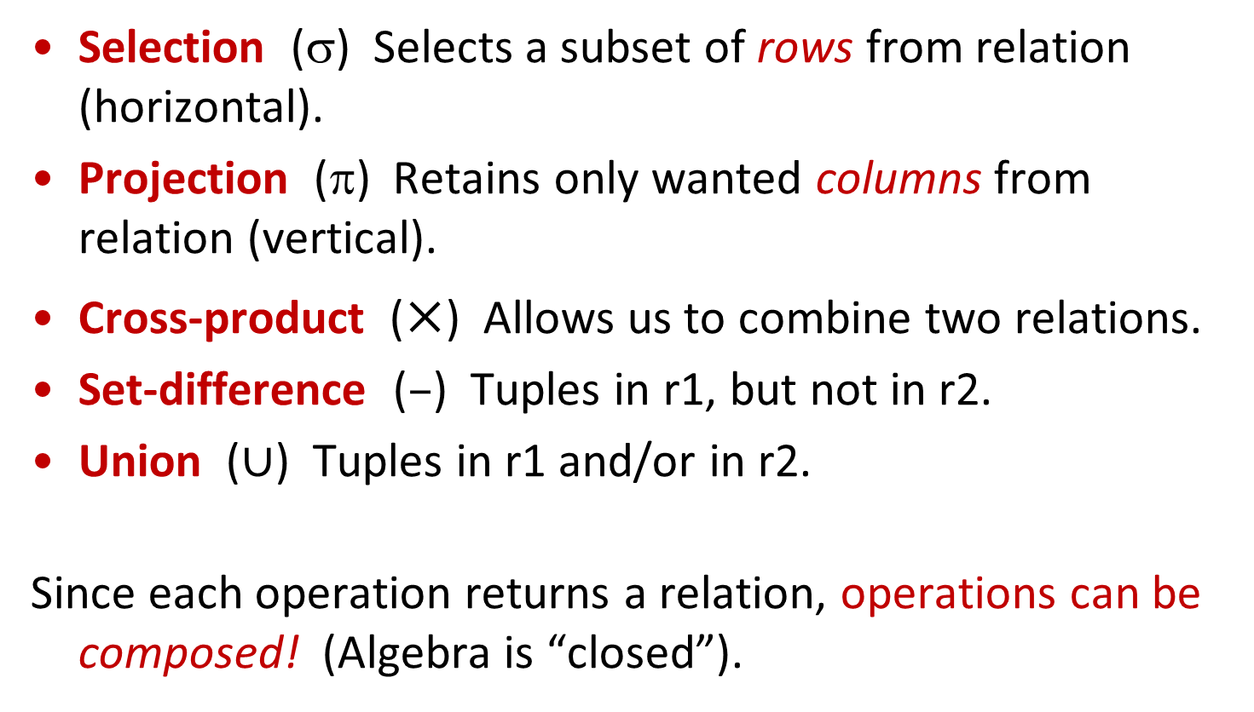
Relational Algebra: 5 Basic Operations
Selection ($$) Selects a subset of rows from relation (horizontal).
Projection ($$) Retains only wanted columns from relation (vertical).
Cross-product ($×$) Allows us to combine two relations.
Set-difference ($–$) Tuples in r1, but not in r2.
Union ($∪$) Tuples in r1 and/or in r2.
Since each operation returns a relation, operations can be composed! (Algebra is “closed”).

Slide 36




Example Schema and Instances
Boats(bid: integer, bname: string, color: string)
Sailors(sid: integer, sname: string, rating: integer, age: real)
Reserves(sid: integer, bid: integer, day:date)
$$Boats$$
bid | bname | color
101 | Interlake | blue
102 | Interlake | red
103 | Clipper | green
104 | Marine | red
$$S1$$
sid | sname | rating | age
22 | Dustin | 7 | 45.0
31 | Lubber | 8 | 55.5
58 | Rusty | 10 | 35.0
$$S2$$
sid | sname | rating | age
28 | yuppy | 9 | 35.0
31 | Lubber | 8 | 55.5
44 | guppy | 5 | 35.0
58 | Rusty | 10 | 35.0
$$R1$$
sid | bid | day
22 | 101 | 10/10/96
58 | 103 | 11/12/96

Slide 37
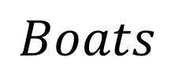


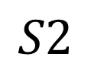


Simplest Relational Algebra Expression
$$Boats$$
$$Output$$
bid | bname | color
101 | Interlake | blue
102 | Interlake | red
103 | Clipper | green
104 | Marine | red
bid | bname | color
101 | Interlake | blue
102 | Interlake | red
103 | Clipper | green
104 | Marine | red
$$Boats$$
$$S2$$
$$Output$$
sid | sname | rating | age
28 | yuppy | 9 | 35.0
31 | Lubber | 8 | 55.5
44 | guppy | 5 | 35.0
58 | Rusty | 10 | 35.0
sid | sname | rating | age
28 | yuppy | 9 | 35.0
31 | Lubber | 8 | 55.5
44 | guppy | 5 | 35.0
58 | Rusty | 10 | 35.0
$$S2$$

Slide 38
Relational Algebra
Selection & Projection
Union, Set Difference & Intersection
Cross product & Joins

Slide 39
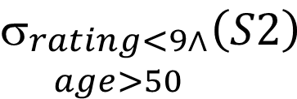

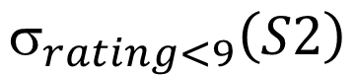




Selection Operator: ($$)
Selects rows that satisfy selection condition.
Output schema of result is same as that of the input relation
$$S2$$
$$Output$$
sid | sname | rating | age
28 | yuppy | 9 | 35.0
31 | Lubber | 8 | 55.5
44 | guppy | 5 | 35.0
58 | Rusty | 10 | 35.0
sid | sname | rating | age
31 | Lubber | 8 | 55.5
44 | guppy | 5 | 35.0
$$_{rating<9}\left(S2\right)$$
$$S2$$
sid | sname | rating | age
28 | yuppy | 9 | 35.0
31 | Lubber | 8 | 55.5
44 | guppy | 5 | 35.0
58 | Rusty | 10 | 35.0
$$Output$$
$$_{\begin{aligned}rating<9∧ \\ age>50\end{aligned}}\left(S2\right)$$
sid | sname | rating | age
31 | Lubber | 8 | 55.5

Slide 40


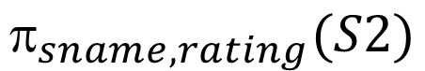
Projection Operator (π)
Retains only attributes that are in the projection list.
Output schema is exactly the fields in the projection list, with the same names that they had in the input relation.
$$S2$$
$$Output$$
sid | sname | rating | age
28 | yuppy | 9 | 35.0
31 | Lubber | 8 | 55.5
44 | guppy | 5 | 35.0
58 | Rusty | 10 | 35.0
sname | rating
yuppy | 9
Lubber | 8
guppy | 5
Rusty | 10
$$_{sname, rating}(S2)$$

Slide 41
Projection Operator (π): Duplicate Elimination
Projection operator has to eliminate duplicates (How do they arise? Why remove them?)
Relational algebra is set based while SQL is bag (multiset) based
$$S2$$
$$Output$$
sid | sname | rating | age
28 | yuppy | 9 | 35.0
31 | Lubber | 8 | 55.5
44 | guppy | 5 | 35.0
58 | Rusty | 10 | 35.0
age
35.0
55.5
$$_{age}(S2)$$

Slide 42


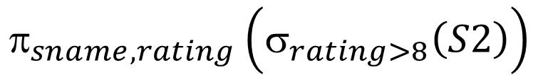
Composing multiple operators
Output of one operator can become input to another operator
$$S2$$
$$Output$$
sid | sname | rating | age
28 | yuppy | 9 | 35.0
31 | Lubber | 8 | 55.5
44 | guppy | 5 | 35.0
58 | Rusty | 10 | 35.0
sname | rating
yuppy | 9
Rusty | 10
$$_{sname, rating}\left(σ_{rating>8}\left(S2\right)\right)$$

Slide 43
Relational Algebra
Selection & Projection
Union, Set Difference & Intersection
Cross product & Joins

Slide 44
Union and Set-Difference
All of these operations take two input relations, which must be union-compatible:
Same number of fields.
“Corresponding” fields have the same type.
For which, if any, is duplicate elimination required?

Slide 45


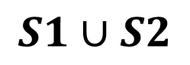

Union operator ($U$)
$$S1$$
sid | sname | rating | age
22 | Dustin | 7 | 45.0
31 | Lubber | 8 | 55.5
58 | Rusty | 10 | 35.0
$$S1∪S2$$
sid | sname | rating | age
22 | Dustin | 7 | 45.0
31 | Lubber | 8 | 55.5
58 | Rusty | 10 | 35.0
44 | guppy | 5 | 35.0
28 | yuppy | 9 | 35.0
$$S2$$
sid | sname | rating | age
28 | yuppy | 9 | 35.0
31 | Lubber | 8 | 55.5
44 | guppy | 5 | 35.0
58 | Rusty | 10 | 35.0

Slide 46


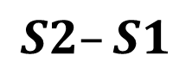
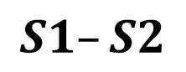

Set Difference Operator ($–$)
$$S1–S2$$
$$S1$$
sid | sname | rating | age
22 | Dustin | 7 | 45.0
31 | Lubber | 8 | 55.5
58 | Rusty | 10 | 35.0
sid | sname | rating | age
22 | Dustin | 7 | 45.0
$$S2$$
sid | sname | rating | age
28 | yuppy | 9 | 35.0
31 | Lubber | 8 | 55.5
44 | guppy | 5 | 35.0
58 | Rusty | 10 | 35.0
$$S2–S1$$
sid | sname | rating | age
28 | yuppy | 9 | 35.0
44 | guppy | 5 | 35.0

Slide 47
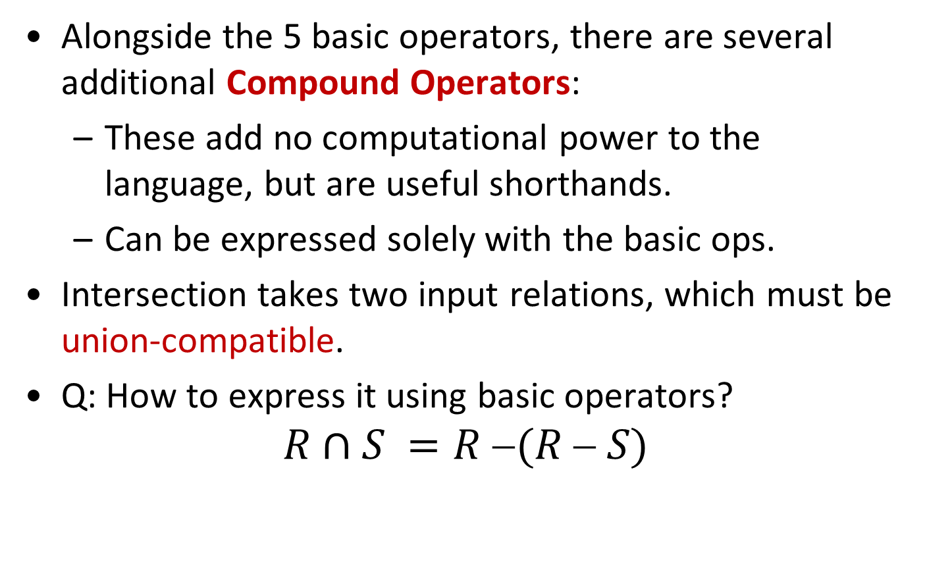
Compound Operator: Intersection
Alongside the 5 basic operators, there are several additional Compound Operators:
These add no computational power to the language, but are useful shorthands.
Can be expressed solely with the basic ops.
Intersection takes two input relations, which must be union-compatible.
Q: How to express it using basic operators?
$$R∩S =R (R  S)$$

Slide 48

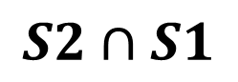

Intersection operator ($∩$)
$$S1$$
sid | sname | rating | age
22 | Dustin | 7 | 45.0
31 | Lubber | 8 | 55.5
58 | Rusty | 10 | 35.0
$$S2∩S1$$
sid | sname | rating | age
31 | Lubber | 8 | 55.5
58 | Rusty | 10 | 35.0
$$S2$$
sid | sname | rating | age
28 | yuppy | 9 | 35.0
31 | Lubber | 8 | 55.5
44 | guppy | 5 | 35.0
58 | Rusty | 10 | 35.0

Slide 49
Relational Algebra
Selection & Projection
Union, Set Difference & Intersection
Cross product & Joins

Slide 50

Renaming Operator (ρ)
Renames the list of attributes specified in the form of oldname → newname or position → newname
Output schema is same as input except for the renamed attributes.
Returns same tuples as input
Can also be used to rename the name of the output relation
$$Boats$$
$$_{bname→boatname, color → boatcolor}\left(Boats\right)$$
bid | bname | color
101 | Interlake | blue
102 | Interlake | red
103 | Clipper | green
104 | Marine | red
bid | boatname | boatcolor
101 | Interlake | blue
102 | Interlake | red
103 | Clipper | green
104 | Marine | red
$$_{2→boatname, 3 → boatcolor}\left(Boats\right)$$

Slide 51

Cross-Product ($×$)
S1 x R1: Each row of S1 paired with each row of R1.
Q: How many rows in the result?
Result schema has one field per field of S1 and R1, with field names “inherited” if possible.
May have a naming conflict: Both S1 and R1 have a field with the same name.
In this case, can use the renaming operator:
$$\left(C\left(1→sid1, 5→sid2\right),S1×R1\right)$$
Call C the result of S1×R1 and respectively rename the 1st & 5th fields of C to sid1 & sid2

Slide 52


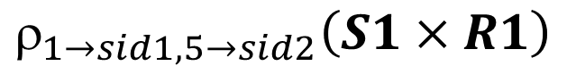
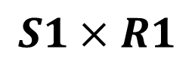
Cross-Product Example
$$S1×R1$$
sid | sname | rating | age | sid | bid | day
22 | Dustin | 7 | 45.0 | 22 | 101 | 10/10/96
22 | Dustin | 7 | 45.0 | 58 | 103 | 11/12/96
31 | Lubber | 8 | 55.5 | 22 | 101 | 10/10/96
31 | Lubber | 8 | 55.5 | 58 | 103 | 11/12/96
58 | Rusty | 10 | 35.0 | 22 | 101 | 10/10/96
58 | Rusty | 10 | 35.0 | 58 | 103 | 11/12/96
$$S1$$
sid | sname | rating | age
22 | Dustin | 7 | 45.0
31 | Lubber | 8 | 55.5
58 | Rusty | 10 | 35.0
$$_{1→sid1, 5→sid2}\left(S1×R1\right)$$
$$R1$$
sid1 | sname | rating | age | sid2 | bid | day
22 | Dustin | 7 | 45.0 | 22 | 101 | 10/10/96
22 | Dustin | 7 | 45.0 | 58 | 103 | 11/12/96
31 | Lubber | 8 | 55.5 | 22 | 101 | 10/10/96
31 | Lubber | 8 | 55.5 | 58 | 103 | 11/12/96
58 | Rusty | 10 | 35.0 | 22 | 101 | 10/10/96
58 | Rusty | 10 | 35.0 | 58 | 103 | 11/12/96
sid | bid | day
22 | 101 | 10/10/96
58 | 103 | 11/12/96

Slide 53
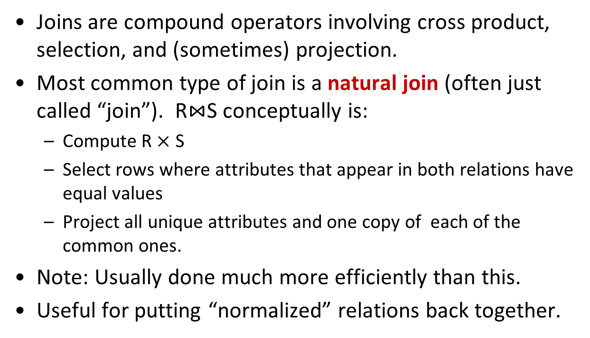
Compound Operator: Join
Joins are compound operators involving cross product, selection, and (sometimes) projection.
Most common type of join is a natural join (often just called “join”). R$⋈$S conceptually is:
Compute R $×$ S
Select rows where attributes that appear in both relations have equal values
Project all unique attributes and one copy of each of the common ones.
Note: Usually done much more efficiently than this.
Useful for putting “normalized” relations back together.

Slide 54


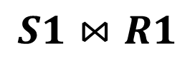
Natural Join Example
$$_{S1.sid,sname,…}\left(σ_{S1.sid=R1.sid}\left(S1×R1\right)\right)$$
$$S1$$
sid | sname | rating | age | sid | bid | day
22 | Dustin | 7 | 45.0 | 22 | 101 | 10/10/96
22 | Dustin | 7 | 45.0 | 58 | 103 | 11/12/96
31 | Lubber | 8 | 55.5 | 22 | 101 | 10/10/96
31 | Lubber | 8 | 55.5 | 58 | 103 | 11/12/96
58 | Rusty | 10 | 35.0 | 22 | 101 | 10/10/96
58 | Rusty | 10 | 35.0 | 58 | 103 | 11/12/96
sid | sname | rating | age
22 | Dustin | 7 | 45.0
31 | Lubber | 8 | 55.5
58 | Rusty | 10 | 35.0
$$R1$$
sid | bid | day
22 | 101 | 10/10/96
58 | 103 | 11/12/96
$$S1⋈R1$$
sid | sname | rating | age | bid | day
22 | Dustin | 7 | 45.0 | 101 | 10/10/96
58 | Rusty | 10 | 35.0 | 103 | 11/12/96

Slide 55


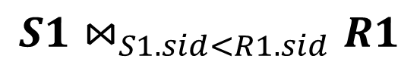
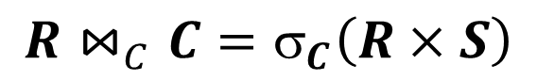
Condition Join or Theta-Join
$$R⋈_{C}C=σ_{C}\left(R×S\right)$$
Output schema same as that of cross-product.
May have fewer tuples than cross-product.
$$S1$$
sid | sname | rating | age
22 | Dustin | 7 | 45.0
31 | Lubber | 8 | 55.5
58 | Rusty | 10 | 35.0
$$R1$$
sid | bid | day
22 | 101 | 10/10/96
58 | 103 | 11/12/96
$$S1⋈_{S1.sid<R1.sid}R1$$
sid | sname | rating | age | sid | bid | day
22 | Dustin | 7 | 45.0 | 58 | 103 | 11/12/96
31 | Lubber | 8 | 55.5 | 58 | 103 | 11/12/96

Slide 56
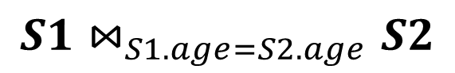

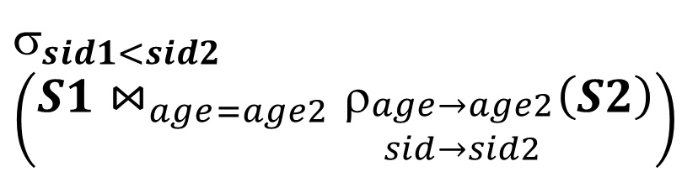
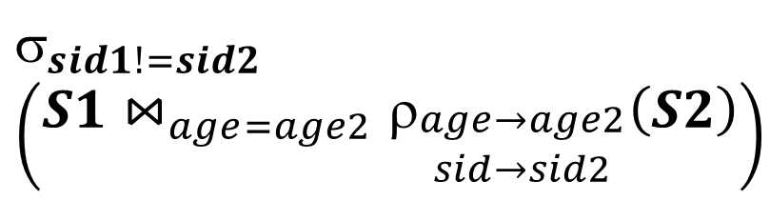
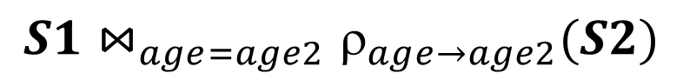
Equi-Join
Special case of theta-join: condition c contains only conjunction of equalities.
Find all pairs of sailors in S2 who have same age.
$$S1⋈_{S1.age=S2.age}S2$$
$$S2$$
sid | sname | rating | age
28 | yuppy | 9 | 35.0
31 | Lubber | 8 | 55.5
44 | guppy | 5 | 35.0
58 | Rusty | 10 | 35.0
$$S1⋈_{age=age2}_{age→age2}(S2)$$
$$_{sid1!=sid2}$$
$$\left(S1⋈_{age=age2}ρ_{\begin{aligned}age→age2 \\ sid→sid2\end{aligned}}\left(S2\right)\right)$$
$$_{sid1<sid2}$$
$$\left(S1⋈_{age=age2}ρ_{\begin{aligned}age→age2 \\ sid→sid2\end{aligned}}\left(S2\right)\right)$$

Slide 57


Slide 58
The SQL Wars

Slide 59
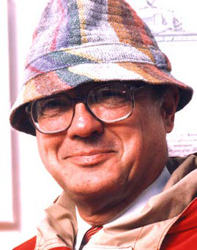
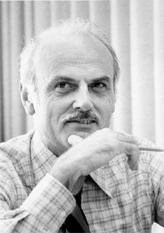
Round I: CODASYL vs SQL
Charles Bachman
Ted Codd
Access db using COBOL
Network data model
Complex queries
Easily corrupted
No data independence
Introduce relational model
Store db in simple structures
Access data via high-level lang
Physical storage up to DBMS

Slide 60
The great debate @ SIGMOD 1975
COBOL crew:
“Relational model is too mathematical”
“Rel. model cannot be implemented efficiently”
“Transaction processing systems want (procedural) tuple-at-a-time operations; not declarative
Relational crew:
“CODASYL proposal too complicated”
“Queries too hard to program”
“CODASYL has no formal foundation”
IBM DB2 used the relational model; the rest followed

Slide 61
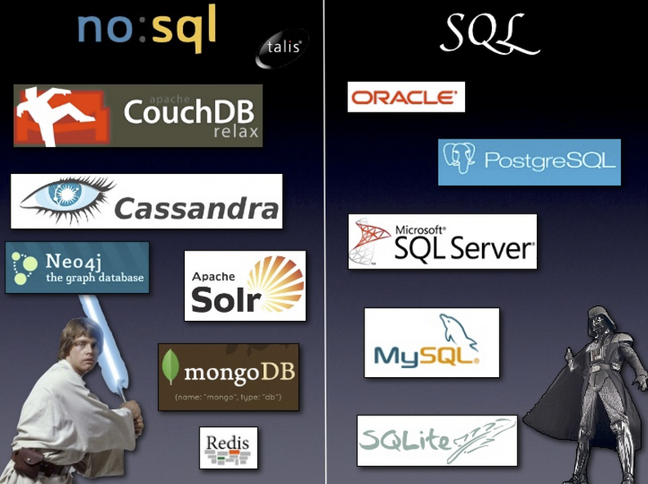
Round II: The (No)SQL Wars

Slide 62
Data Models
Relational
Key/Value
Graph
Document
Column-family
Array / Matrix
Hierarchical
Network
NoSQL

Slide 63
Birth of NoSQL (Not-Only SQL)
Non-relational data model
Claim: Non-relational data (unstructured, semistructured, hierarchical..)
Flexible or evolving schema
Claim: “Schema-upfront” DBMS approach not agile
Simple call-level interface (not SQL)
Claim: Cater for specific application (memcached), complex analytics
Basically Available Soft state Eventual consistency
Claim: ACID serializability doesn’t scale
Horizontal scaling
Claim: Relational DBMS only scales vertically
Notes:
So far we talked about representing information in a tabular form.
We defined real-world entities, and saw how to place this information in tables.
Some applications, however, have different requirements. Developers of these applications were treating the relational model as a “necessary evil”. They thought it was too restricting, or not expressive enough.
They preferred enforcing constraints in their applications, and representing nested data, that had very explicit hierarchical relationships in them, without having to split them in multiple tables.
This trend first was very active when XML became popular. Later on, when cloud became a buzzword, this trend was dubbed NoSQL.
NoSQL proposes variations in a number of the traditional database layers. For now, we will focus on the data model variations.

Slide 64
NoSQL systems: Data models
Key-Value stores
Ex: Voldemort, Riak, Redis
Structural aspect: Associative array
Manipulation aspect: get, put
Document stores
Ex: SimpleDB, CouchDB, MongoDB
Structural aspect: “Document” ( = <scalar> <document/list>)
Manipulation aspect: “View” (queries in javascript)

Slide 65
NoSQL systems: Data models
Extensible record stores (wide column stores)
Ex: BigTable, Hbase, HyperTable, Cassandra
Structural aspect: “Tables” rows and columns
Rows are more like documents than tuples
variable #columns
Rows grouped into a table
Columns similar to attributes in relational model
Scalar, Usually no nested types
Manipulation aspect: record-level get/put

Slide 66
NoSQL vs Relational: Example
since
One table for Employees, Department entities
Merge Manages relationship with department
name
dname
ssn
lot
did
budget
Employees
Manages
Departments
CREATE TABLE Employee (
ssn CHAR(11),
name CHAR(20),
lot INTEGER)
CREATE TABLE Dept_Mgr(
did INTEGER,
dname CHAR(20),
budget REAL,
ssn CHAR(11),
since DATE)
Notes:
7

Slide 67
Same data in key-value store
name
dname
ssn
lot
did
budget
Employees
Manages
Departments
Store all employee info in employee object
Store employee object as the “value” for a “key”
class Employee
{
int ssn;
string name;
int lot;
list<Department> managedDepts;
}
private class Department
{
int did;
string dname;
int budget;
}
Notes:
5

Slide 68
Same data in key-value store
name
dname
ssn
lot
did
budget
Employees
Manages
Departments
Store all employee info in employee object
Store employee object as the “value” for a “key”
123-22-3666
231-31-5368
131-24-3650
Attishoo | 48 | [(51,IT,1000),(56,Accounting,3000)]
Smiley | 22 | [(51,IT,1000)]
Smethurst | 35 | []
Notes:
5

Slide 69
Same data in document store
Store data + schema in a JSON document
JSON Document {
"id": 123223666, "name": "Attishoo",
"manages": [{"did": 51, "name": "IT",
"budget": 1000}, {"did": 56, "name": "Accounting",
"budget": 3000}]
}

Slide 70
NoSQL: Not-so-new SQL (atleast wrt data model)
Object-oriented databases
Persisting objects in OO applications, supports nesting
Ex: Gemstone
Graph databases
Supports complex graph traversals, graph querying
Ex: Neo4j
Relational++
Object-relational extensions
Text, XML, JSON, graph extensions to SQL/relational DBMS

Slide 71
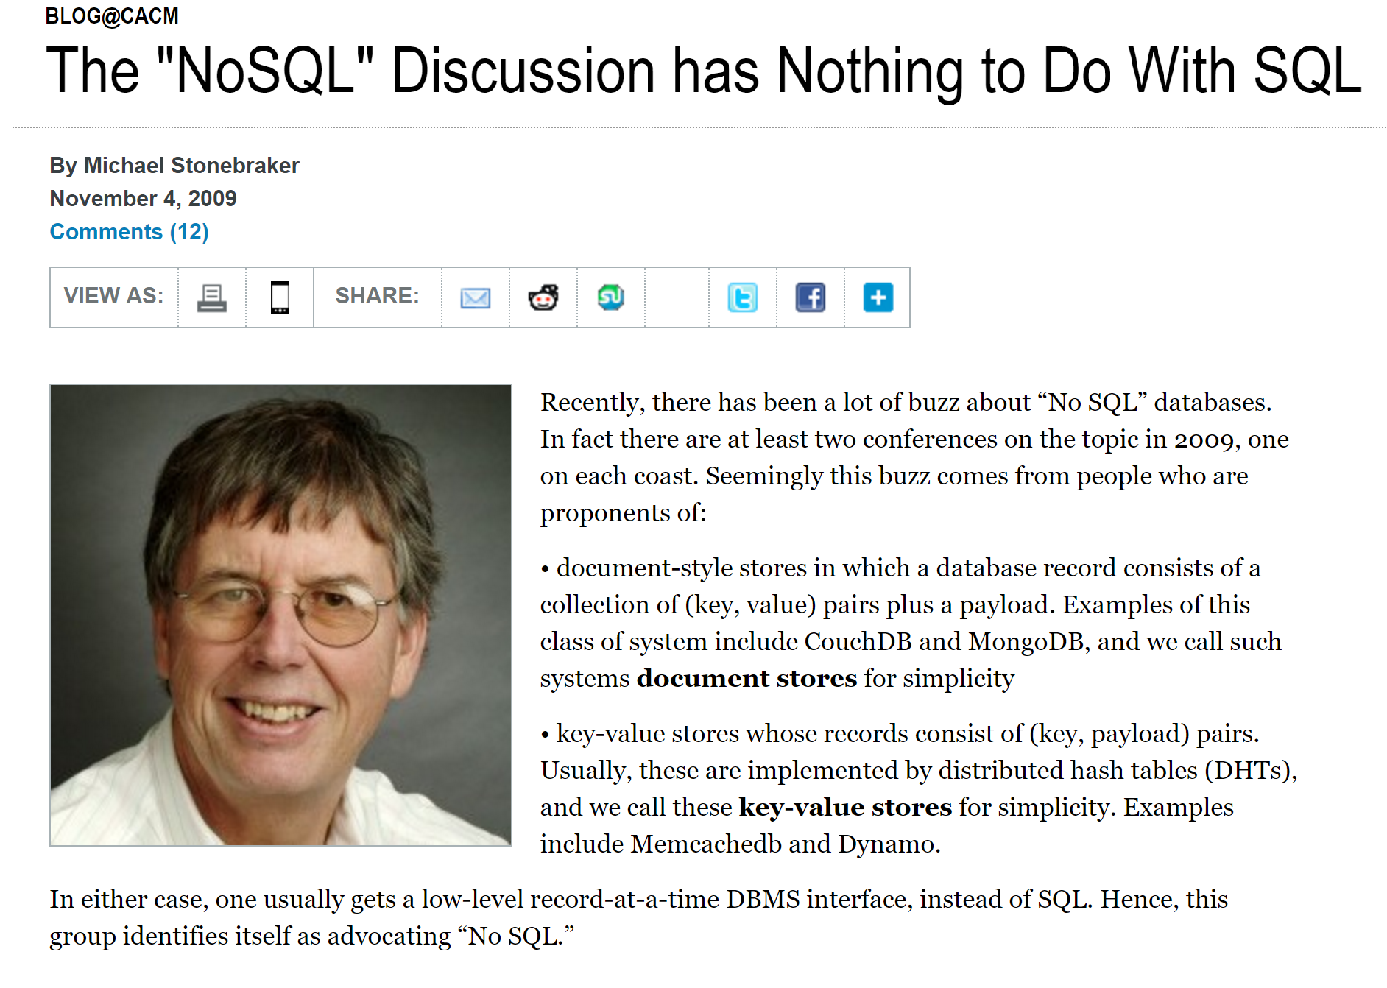
NoSQL: Not-so great SQL (atleast wrt features)
“It’s all about performance or flexibility, not about SQL”

Slide 72
Conclusion
DBMS used to maintain, query large datasets
Most DBMS have a relational flavor, for legacy / performance reasons
This course: DBMS principles, and DBMS evolution to BDMS (“big data management systems”)

